Slide 1
Cloud Based Data Engineering
Lecture 7: Spark

Slide 2
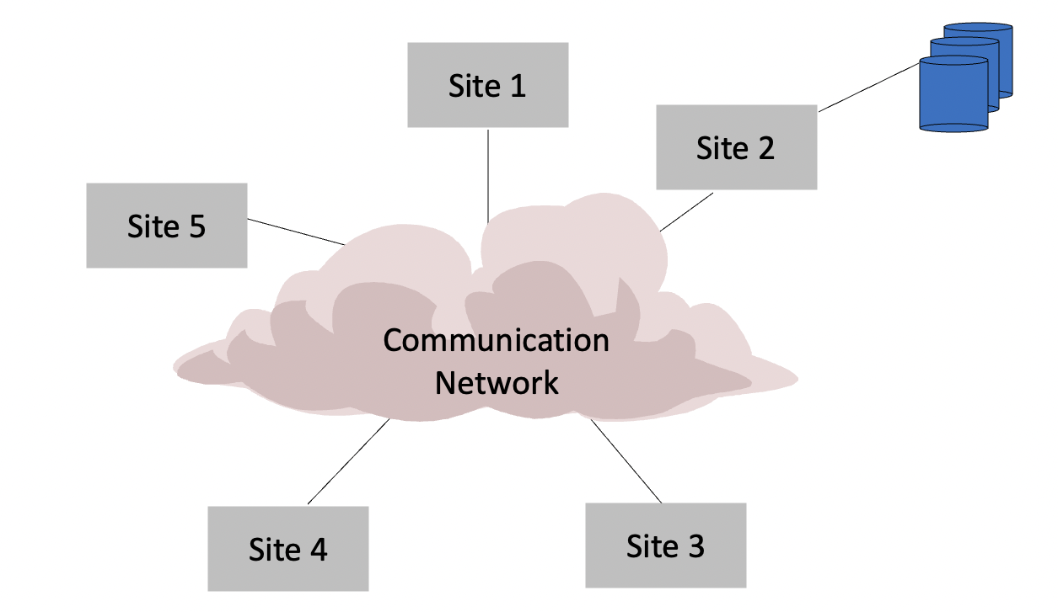
Centralized DBMS

Slide 3
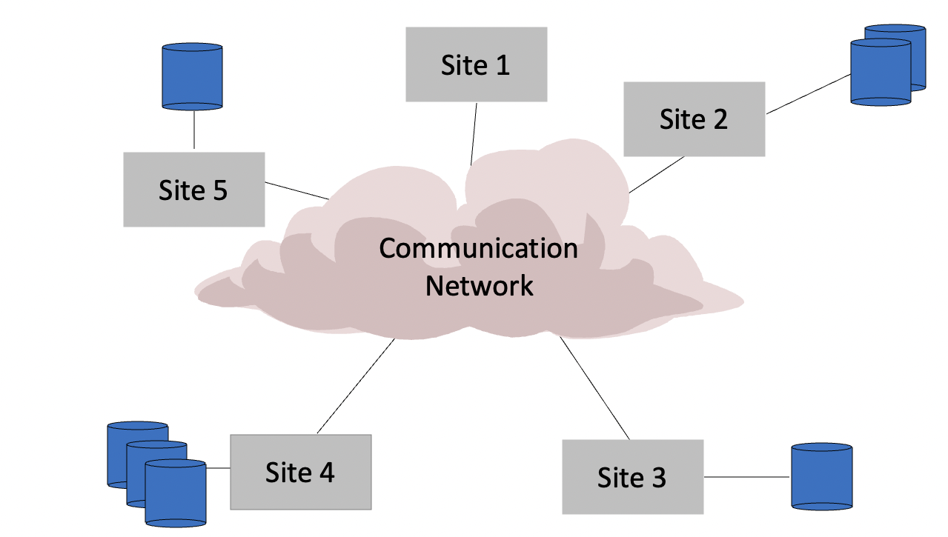
Distributed DBMS

Slide 4
GFS

Slide 5

GFS – Google File System
Google File System (GFS) is a distributed file system developed by Google.
A scalable distributed file system for large distributed data intensive applications
Designed for system-to-system interaction, and not for user-to-system interaction.

Slide 6
GFS – Key Observations
Component failures are the norm - constant monitoring, error detection, fault tolerance
Huge files - Multi GB files are common I/O operations
Files are mutated by appending new data - focus of performance optimization
Co-designing the applications and APIs benefits overall system by increasing flexibility

Slide 7
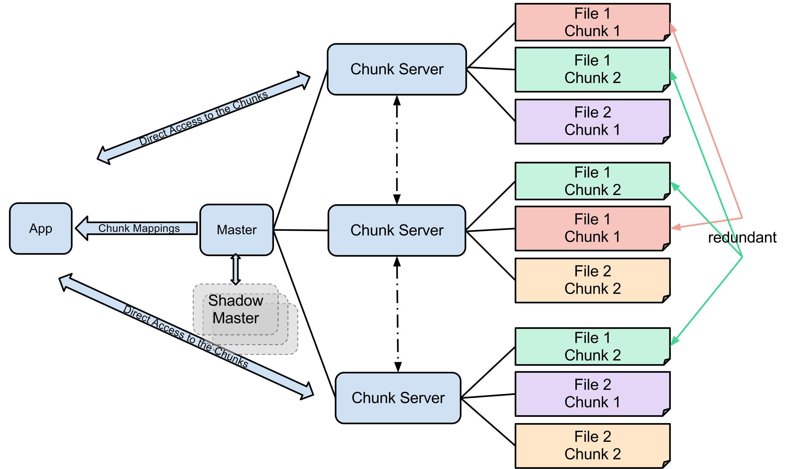
GFS Architecture

Slide 8
The Master
Communicates with chunk-servers
Give instructions
Maintains all file system metadata
Helps make sophisticated chunk placement and replication decision
For reading and writing, client contacts Master to get chunk locations, then deals directly with chunkservers

Slide 9
Chunkservers
Files are broken into chunks.
Chunk size is 64 MB
Each chunk is replicated on 3 (default) servers

Slide 10
Hadoop

Slide 11

HADOOP
Hadoop runs applications using the MapReduce algorithm,
where the data is processed in parallel with others.
Hadoop is used to develop applications that could perform complete statistical analysis on huge amounts of data.

Slide 12
HADOOP
Allows distributed processing of large datasets across clusters of computers
Hadoop is designed to scale up from single server to thousands of machines
It provides a distributed file system (HDFS) that stores data on the compute nodes, providing very high aggregate bandwidth across the cluster.

Slide 13
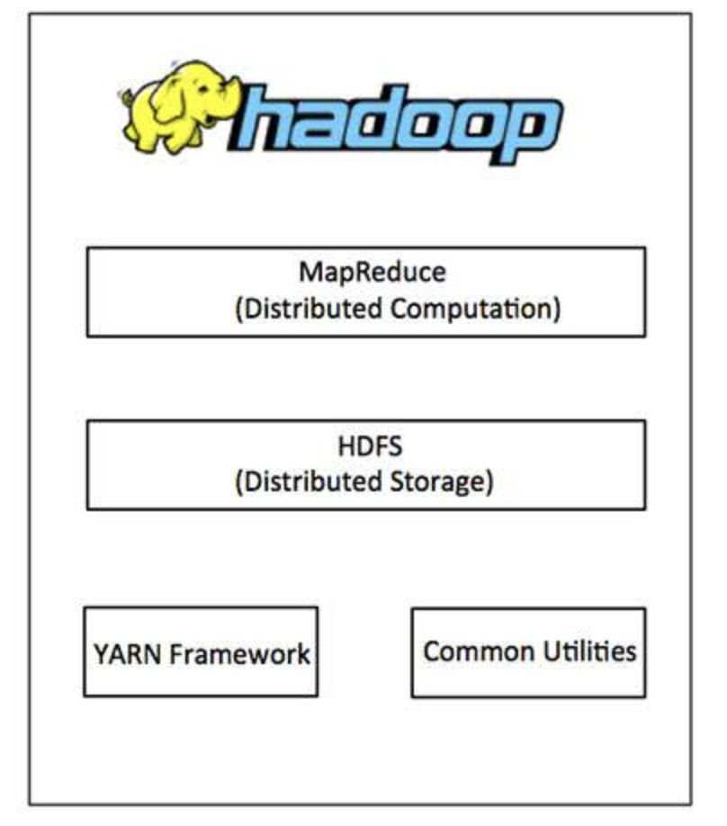
HADOOP Architecture
Hadoop has two major layers:
Processing/Computation layer (MapReduce)
Storage layer (Hadoop Distributed File System - HDFS)

Slide 14
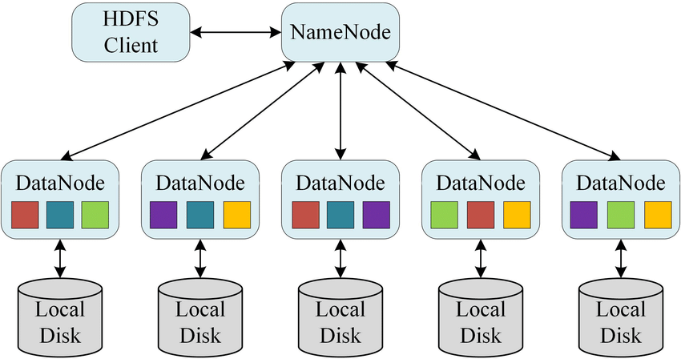
HDFS
The Hadoop Distributed File System (HDFS) is based on the Google File System (GFS) and provides a distributed file system that is designed to run on commodity hardware. It has many similarities with existing distributed file systems.

Slide 15

Spark
Apache Spark is a fast and general-purpose cluster computing system.
Provides high-level APIs in Java, Scala, Python and R.
Optimize engine that supports general execution graphs.
Can manage "big data" collections with a small set of high-level primitives like
map, filter, group-by, and join.
Supports a rich set of higher-level tools including Spark SQL.

Slide 16
RDD - Resilient Distributed Datasets
- RDDs behave like Python collections (e.g. lists).
- Spark iteratively apply functions to every item of these collections in parallel to produce new RDDs.
- The data is distributed across nodes in a cluster of computers.
- Functions implemented in Spark can work in parallel across elements of the collection.
- RDDs automatically rebuilt on machine failure.

Slide 17
Operations in Distributed DBs
Two types of operations: transformations and actions
- Transformations are lazy (not computed immediately)
- Transformations are executed when an action is run
Transformations
map()
filter()
union()
distinct()
groupBy()
…
Actions
reduce()
collect()
count()
first()
saveAsTextFile()
..

Slide 18
Sample Spark transformations
map(func): passing each element of the source through func
filter(func): selecting those elements of the source on which returns true
union/intersection(otherDataset): contains the union/intersection of elements
join(otherDataset, [numTasks]): When called on datasets of type (K, V) and (K, W),
returns a dataset of (K, (V, W)) pairs with all pairs of elements for each key.
Outer joins are supported through leftOuterJoin, rightOuterJoin, and fullOuterJoin.

Slide 19
Operations in Distributed DBs - Transformation
map() flatMap()
filter()
mapPartitions() mapPartitionsWithIndex()
sample()
union() intersection() distinct()
groupBy() groupByKey()
reduceBy() reduceByKey()
sortBy() sortByKey()
join()
cogroup()
cartesian()
pipe()
coalesce()
repartition()
partitionBy()

Slide 20
Sample Spark Actions
reduce(func): Aggregate the elements of the dataset using a function func (which takes two arguments and returns one). The function should be commutative and associative so that it can be computed correctly in parallel.
collect(): Return all the elements of the dataset as an array at the driver program.
This is usually useful after a filter or other operation that returns a sufficiently small subset of the data.
count(): Return the number of elements in the dataset.
Actions cause calculations to be performed
transformations just set things up (lazy evaluation)

Slide 21
Operations in Distributed DBs - Actions
reduce()
collect()
count()
first()
take()
takeSample()
saveToCassandra()
takeOrdered()
saveAsTextFile()
saveAsSequenceFile()
saveAsObjectFile()
countByKey()
foreach()

Slide 22
Spark – RDD Persistence
You can persist (cache) an RDD
When you persist an RDD, each node stores any partitions of it that it computes in memory and reuses them in other actions on that dataset (or datasets derived from it)
Allows future actions to be much faster (often >10x).
Can choose storage level (MEMORY_ONLY, DISK_ONLY, MEMORY_AND_DISK, etc.)
Can manually call unpersist()

Slide 23
RDD – Key Observations
RDDs can be created from Hadoop InputFormats (such as HDFS files), “parallelize()” datasets, or by transforming other RDDs (you can stack RDDs)
Actions can be applied to RDDs; actions force calculations and return values
Lazy evaluation: Nothing computed until an action requires it
RDDs are best suited for applications that apply the same operation to all elements

Slide 24
Life Cycle of Spark Program
1. Create input RDDs from external data or parallelize a collection in your driver program.
2. Lazily transform them to define new RDDs using transformations like `filter()` or `map()`
3. Ask Spark to cache() any intermediate RDDs that will need to be reused.
4. Launch actions such as count() and collect() to kick off a parallel computation, which is then optimized and executed by Spark.

Slide 25
Spark DataFrames
Enable wider audiences beyond “Big Data” engineers to leverage the power of distributed processing.
Inspired by data frames in R and Python (Pandas)
Designed from the ground-up to support modern big data and data science applications
Extension to the existing RDD API

Slide 26
DataFrames Are..
The preferred abstraction in Spark
Strongly typed collection of distributed elements
Built on Resilient Distributed Datasets (RDD)
Immutable once constructed

Slide 27
With DataFrames You Can..
With DataFrames you can:
Track lineage information to efficiently recompute lost data
Enable operations on collection of elements in parallel
construct DataFrames:
by parallelizing existing collections (e.g., Pandas DataFrames)
by transforming an existing DataFrames
from files in HDFS or any other storage system (e.g., Parquet)

Slide 28
Apache Spark: Libraries “on top” of core that come with it
Spark SQL
Spark Streaming – stream processing of live datastreams
MLlib - machine learning
GraphX – graph manipulation
  extends Spark RDD with Graph abstraction: a directed multigraph with properties attached to each vertex and edge.

Slide 29
Gray sort competition: Winner
 | Hadoop MR Record | Spark Record (2014)
Data Size | 102.5 TB | 100 TB
Elapsed Time | 72 mins | 23 mins
# Nodes | 2100 | 206
# Cores | 50400 physical | 6592 virtualized
Cluster disk throughput | 3150 GB/s (est.) | 618 GB/s
Network | dedicated data center, 10Gbps | virtualized (EC2) 10Gbps network
Sort rate | 1.42 TB/min | 4.27 TB/min
Sort rate/node | 0.67 GB/min | 20.7 GB/min
Sort benchmark, Daytona Gray: sort of 100 TB of data (1 trillion records)

